Slide 1
Woodlands CS Club
January 4th, 2021

Slide 2
Announcements:
Our school will unfortunately not be hosting the Canadian Computing Competition (CCC) this year. If you are still interested in writing this contest you will have to register externally (Example: Olympiads School, although the fee is more expensive)
We will be hosting our own contest similar to the format of the CCC.
The CCC is running around February 17th this year, so make sure to register as soon as possible if you intend to write.
J

Slide 3

Purpose of Git
What is Git?
Git is a modern version-control system which is used for tracking changes in any sets of files.
Git is the most commonly used version control system currently.
Purpose
Git tracks the changes that you make to files, allowing you to to keep a record of what you have done and enabling you to revert to specific versions if needed.
Git also makes collaboration easier by allowing changes by multiple people to be merged into one source tree.
R

Slide 4

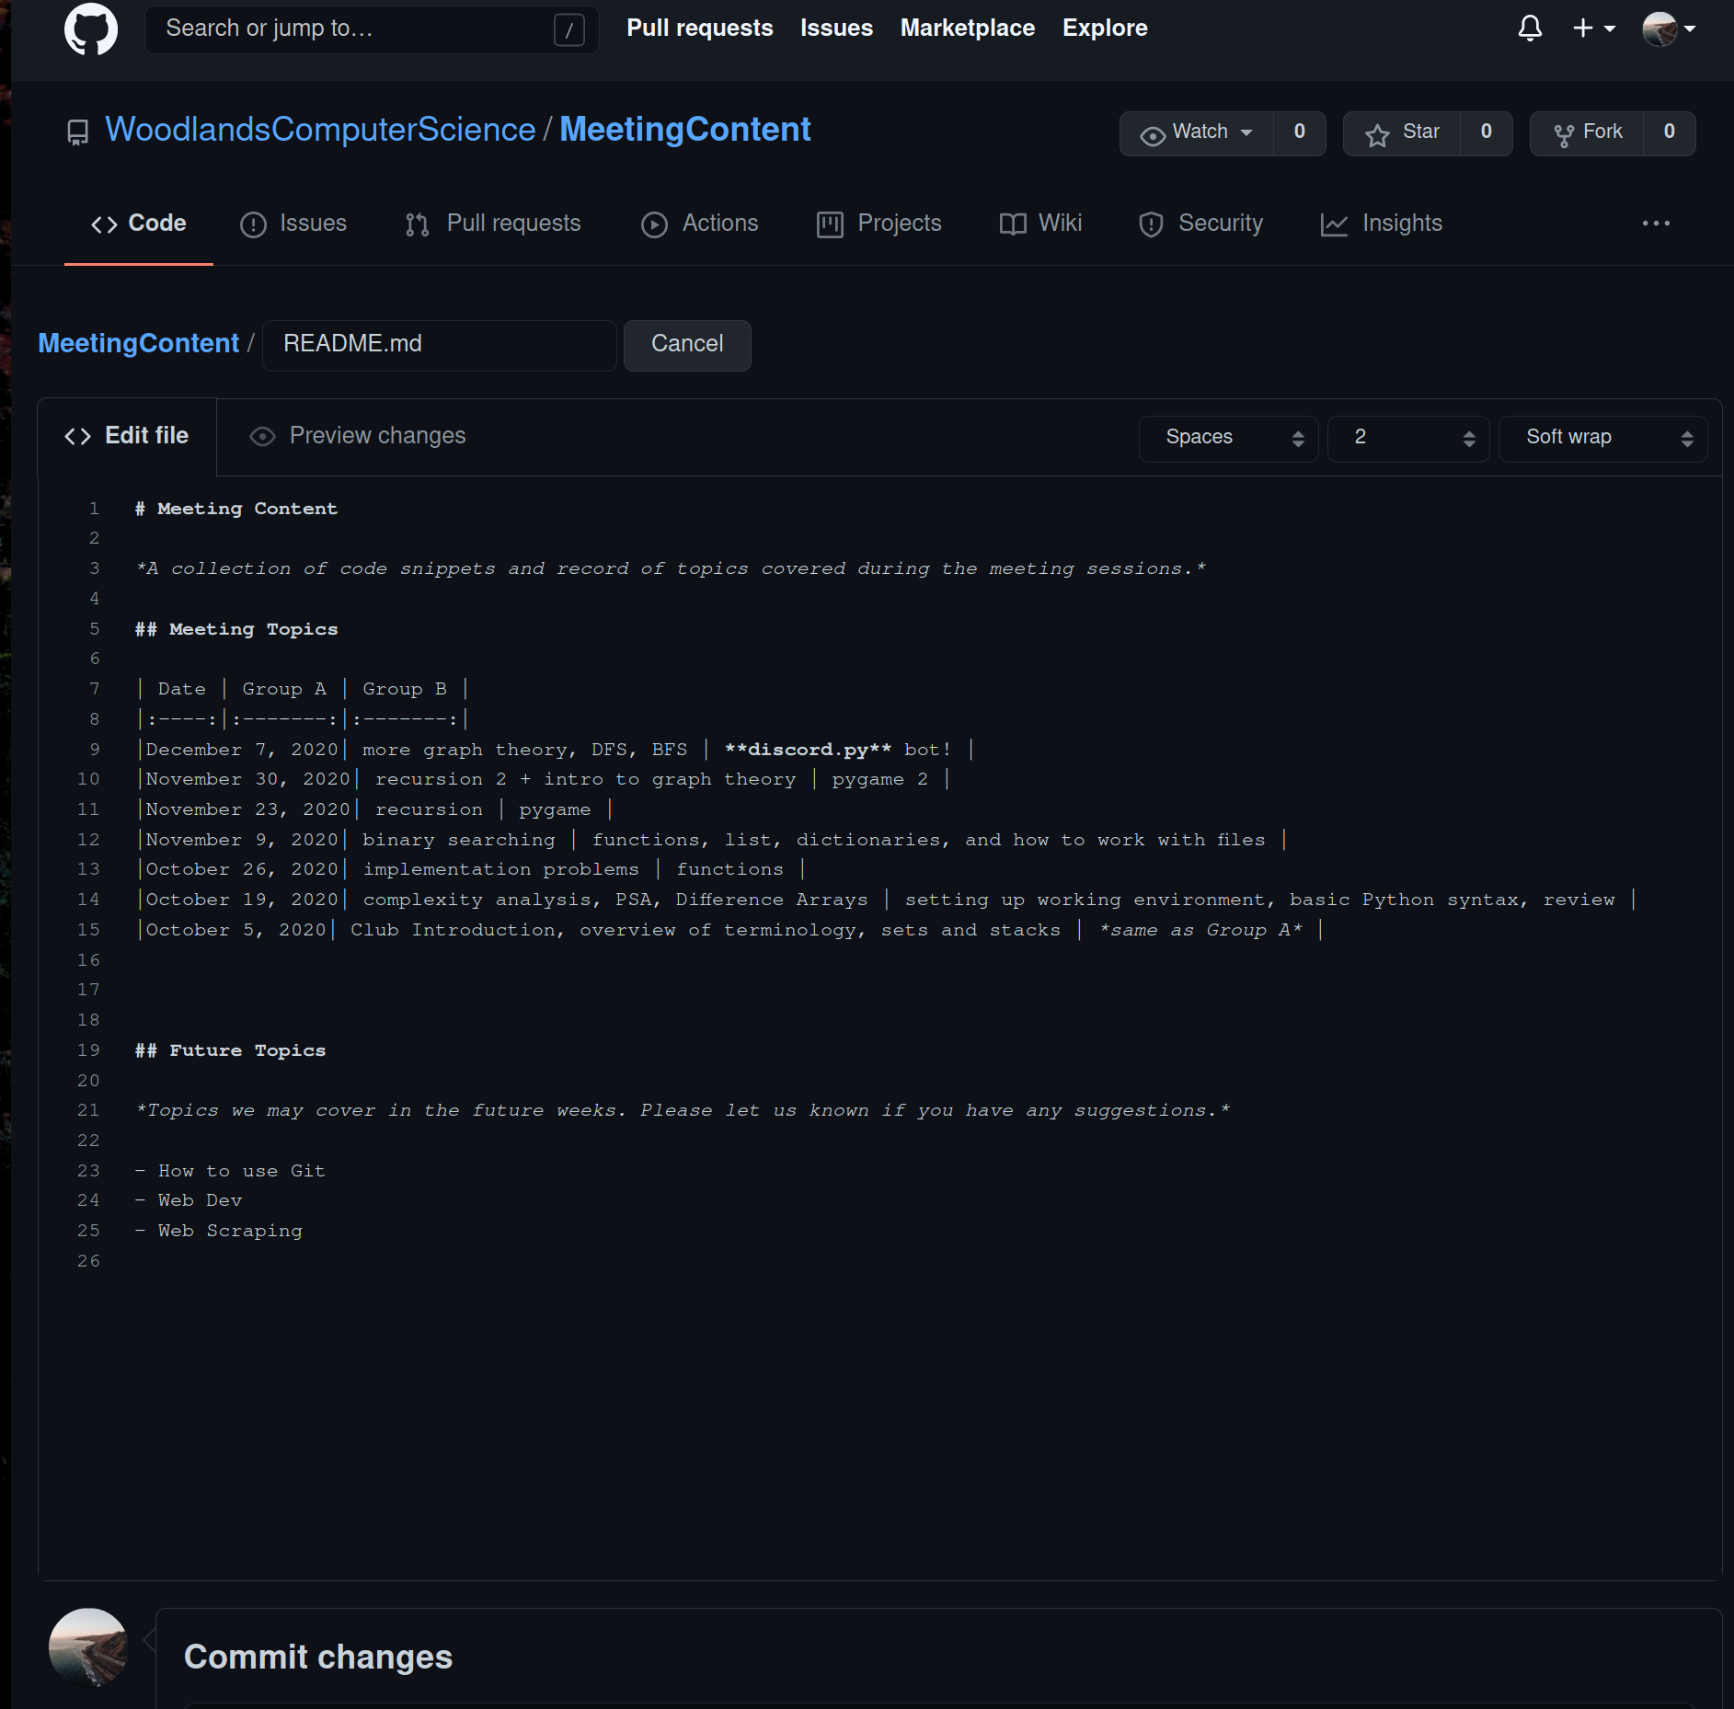
Creating a Github account
Head over to https://github.com/
Click sign up in the top right corner
Fill out the sign up form
Remember not to use your school email for the email address section!
Github is a popular Git "provider", backed by Microsoft, that also offers other services such as issue tracking, wiki, static website hosting and a web-based editor. We’ll get into how to use Github and Git in this presentation.
N

Slide 5

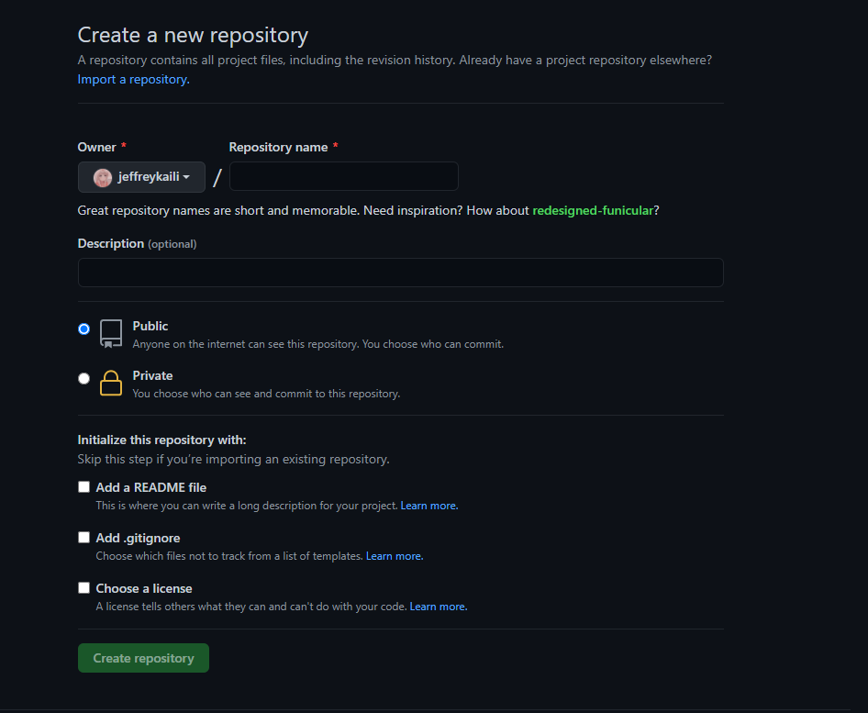
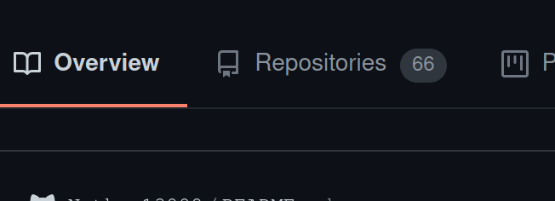
Creating your first repository
Head over to https://github.com/ (make sure you are signed in)
Click the + button in the top right
Click on New repository option from the dropdown menu
A page similar to the one on the bottom of the slides should appear. Give your repository a name and description! Do not worry about ticking any of boxes below the public/private repository options.
Click Create repository.
Your Github repository is now created! If you want to see your repositories, navigate to
https://github.com/, click your icon in the top right of
the page and select Your repositories from the dropdown
menu.
X

Slide 6
Installation Instructions
Instructions to install Git for your operating system can be found below:
https://git-scm.com/book/en/v2/Getting-Started-Installing-Git

Slide 7
Git Branching and Strategies
Branching is a fundamental part of Git and allows for organization of different ideas and stages in the development process. It allows the users to test ideas and changes to the source tree in a separate branch.
If an idea doesn't work, then the branch could be simply deleted. Otherwise, changes could be "merged" into another branch for others to see. In addition, branching is particularly important for large projects or open sourced projects where not all users have direct write access to the repository. It allows for code review by others and other CI related processes to check, verify and test the code.
M

Slide 8
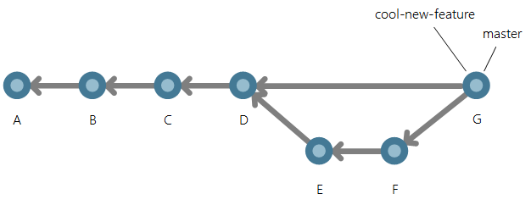
Git branching cont
Git branch - list all branches
Git checkout -b <name> - create and switch to branch, remove -b flag if branch already exists
Git merge - merge two branches

Slide 9
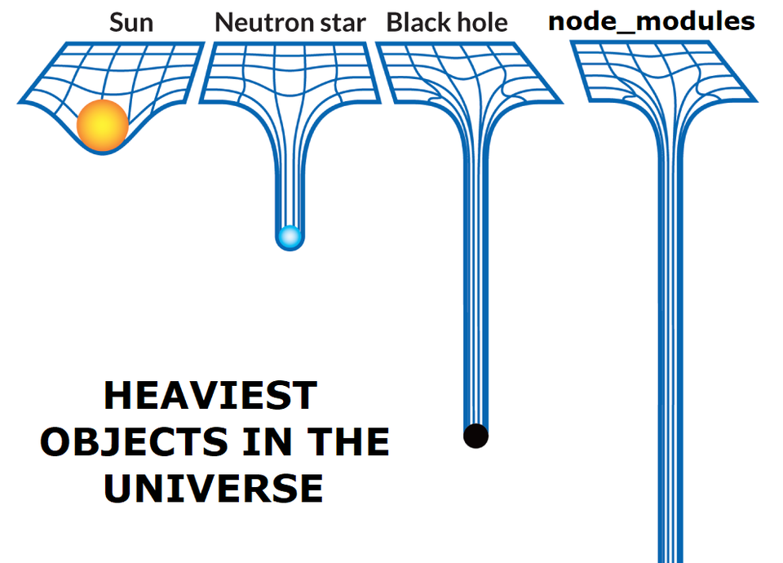
Special Files: .gitignore and .gitkeep
There are some special files in Git that affect how Git interacts with your project files.
There are certain files that may be large or unnecessary to commit in your Git project. The .gitignore file is a hidden file that allows you specify certain files to be "ignored" by Git. Likewise, .gitkeep (used less often) does the opposite.
Normally, these ignored files would be generated or recreated in another local copy of the Git project.
Example: if you are using Node.js, then you will most likely ignore "node_modules".
N

Slide 10
Deleting and Moving Files
`git rm` is a command used to remove a file from a Git repository. By default, this command deletes the file from both the repository and the local filesystem. In cases where you intend to keep the file locally, you can add the `--cached` flag. Other options for the removing files can be found in the documentation here.
`git mv` is a command used to move or rename files/directories. This command achieves the same effect as dragging and dropping a file to move it and deleting and creating a new file with identical content to rename it, but this is considered bad practice. This is because the file(s) will appear deleted and then created elsewhere as a completely new file, losing all previous changes that have been made to the old file. In order to connect these previous changes to the renamed or moved file, the git mv command should be used. More information about this command can be found here.
J

Slide 11
Making "Commits"
Commits are a crucial part of Git. It is the action of recording new changes into the git source tree. This also creates a log which shows the changes to any particular file(s).
However, after commiting a change, you must "push" the change to a "remote" repository before others could see your new change.
Note: it is bad practice to make large commits which makes it difficult to understand what was changed. However, too many commits could lead to a messy Git history.
X

Slide 12
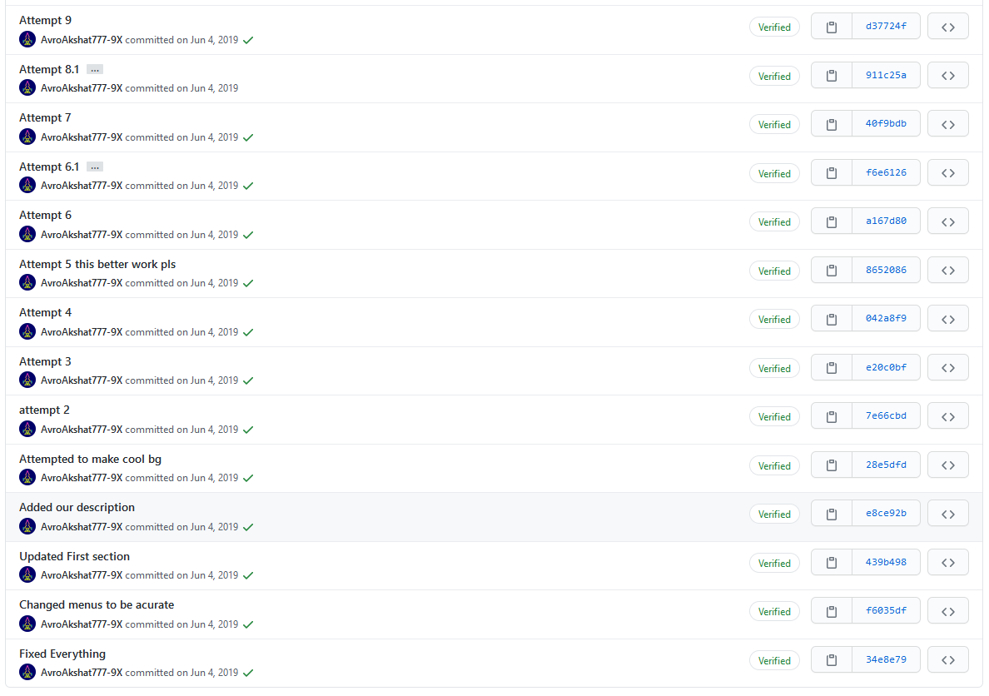
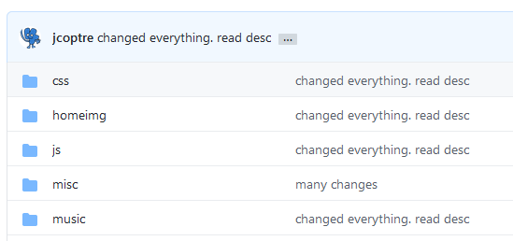
Bad Commits
X

Slide 13
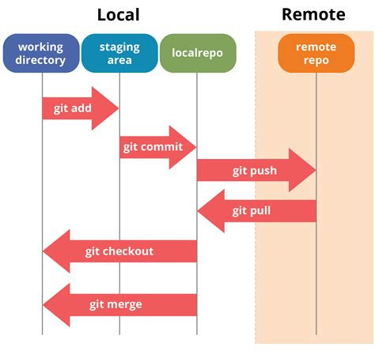
Pushing and Pulling (and Fetching)
The act of "pushing"and "pulling" is just taking in changes or changing a remote repository. These commands are “git push” and “git pull” respectively. It is important to note that when pulling or pushing, git will try to merge changes automatically, but if that cannot happen (e.g. the same line of code being edited twice) there will be a merge conflict.
M

Slide 14
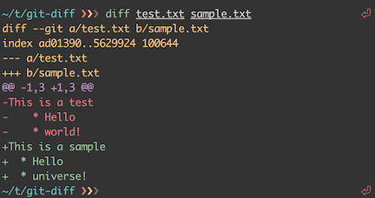
Undoing Mistakes
Git diff is a command showing changes made between commits, branches, etc.
Git restore, revert, and reset
“git restore [--worktree or --staged] <file>” reverts non-committed changes to the last commited version
“git revert [commit]” undoes changes in a particular commit
“git reset [commit]” permanently changes commit history and repository
“git reset --soft [commit]” / “git reset --hard [commit]”
“git push --force/-f” allows pushing a commit without pulling the latest commits
R

Slide 15
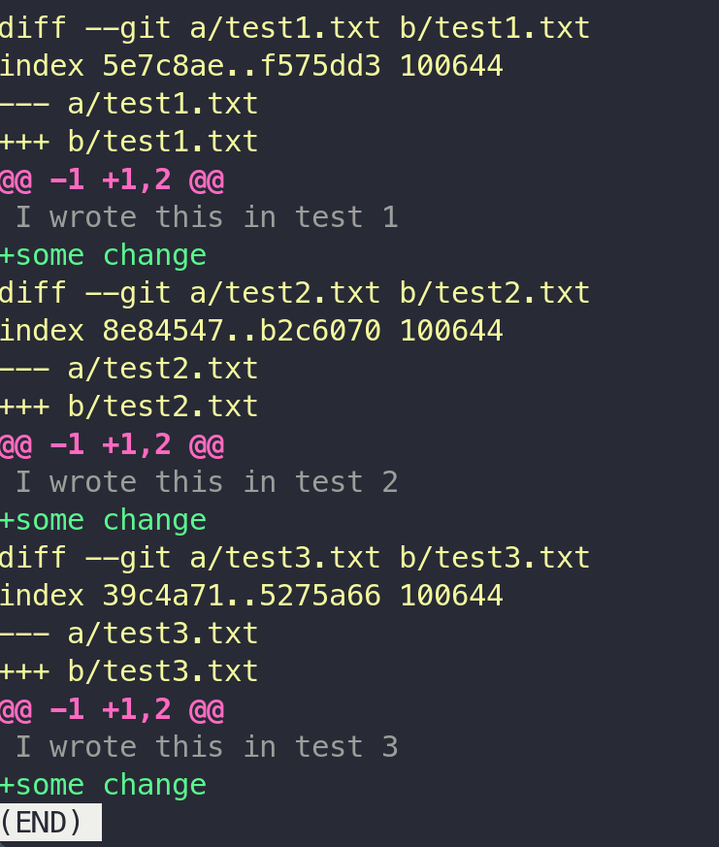
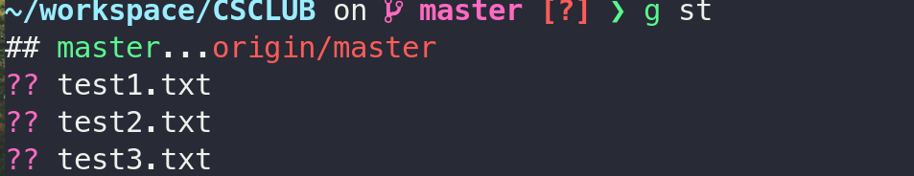
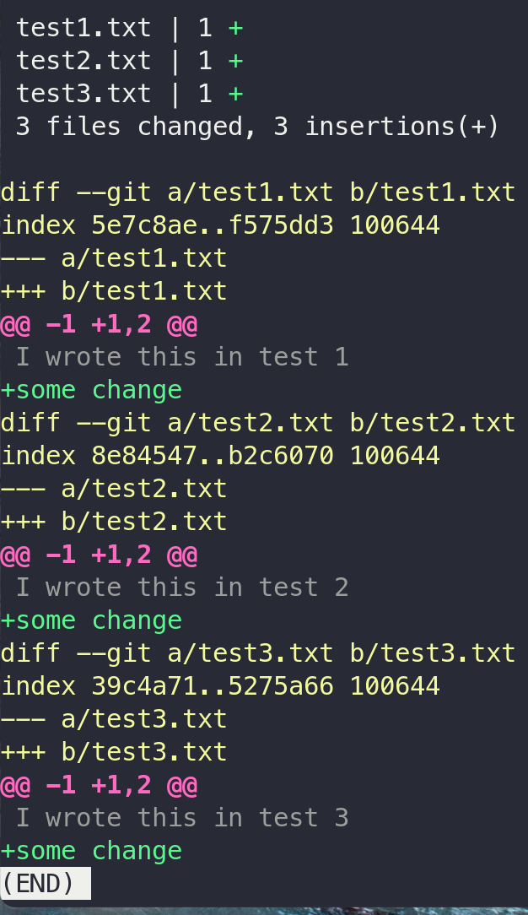
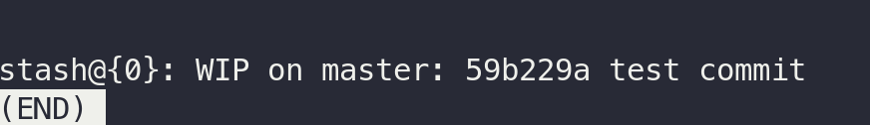
Git Logging: diff, logs, status, etc...
Diff Logs - `git diff [file or directory here]`
Commit Logs - `git status [-sb]`
View Branches - `git branch -vv`
View Remotes - `git remote -vv`
View Stashed Changes - `git stash list` and `git stash show`
M

Slide 16
"Stashing" Changes
What is stashing?
Stashing allows you to temporarily store changes you’ve made to your project and reapply them later on.
This is useful if you want to work on something else but you aren’t quite ready to commit the changes you’ve made to your project yet. A stash will take all your changes, save them inside the hidden .git folder and then revert your project back to the working copy. Stashing can also be used when you have made changes to the incorrect branch and you want to move these changes to a different branch.
Essentially, stashing is a convenience method which allows you store some changes you don’t need at the current moment but may need in the future.
How to stash
To make a stash, simply run the `git stash` command and all your changes will be removed then saved to your stash. Only you could see the stashed changes and they are stored locally.
J

Slide 17
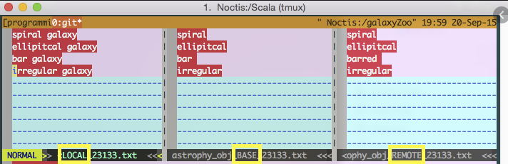
Merging things and Merge Conflicts
An important feature of Git is branching. However, in order to combine changes from different branches, a "merge" must be made between the branches.
If there are conflicting changes to the same file(s), the person making the merge must resolve these conflicts using a "mergetool" or by manually fixing the conflict. A special type of commit called a "merge commit" is then made to record the final changes in the merge. There are several types of merges that have their own nuances but a "merge commit" is the most common and works well in most cases.
X

Slide 18
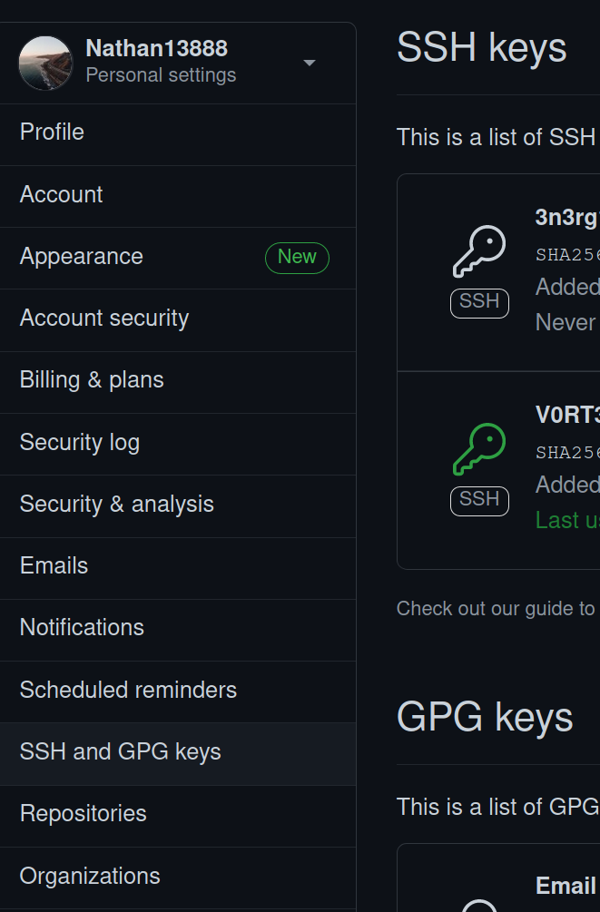
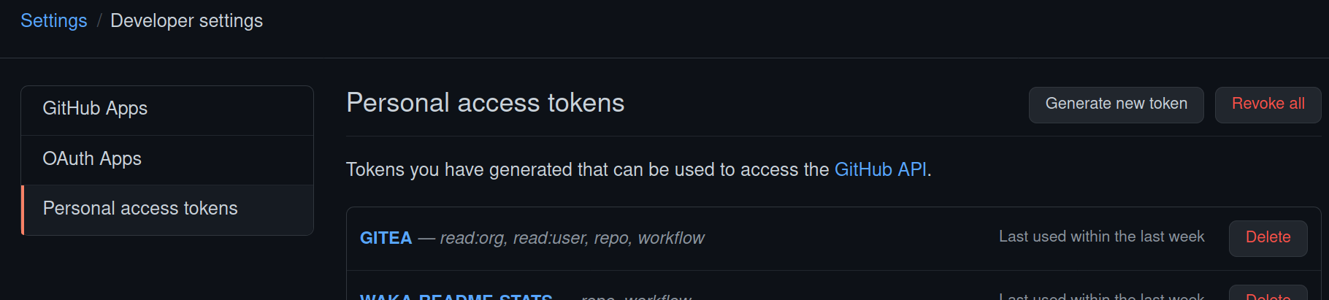
Authentication: HTTPS and SSH
There are two methods of authentication for Git: HTTPS and SSH
HTTPS - the most common form of authentication is with HTTPS
works well with firewalls
non-Linux users could use HTTPS with no problem
easy to use → just user/password combo
annoying for 2FA-enabled accounts on Github
password caches (with "credential helpers") can be a problem
SSH - "Secure Shell" using port 22
more secure and only requires a SSH key
problems with firewalls
problems with Windows users
requires additional setup in exchange for convenience afterwards
The switch between the two types of authentication, change the url of the remotes
N

Slide 19
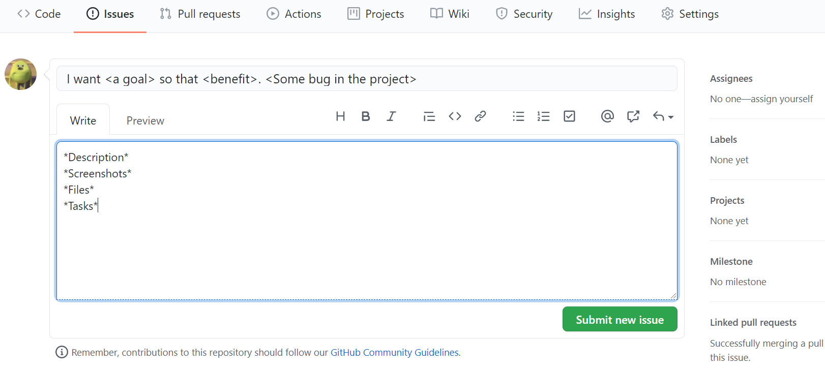
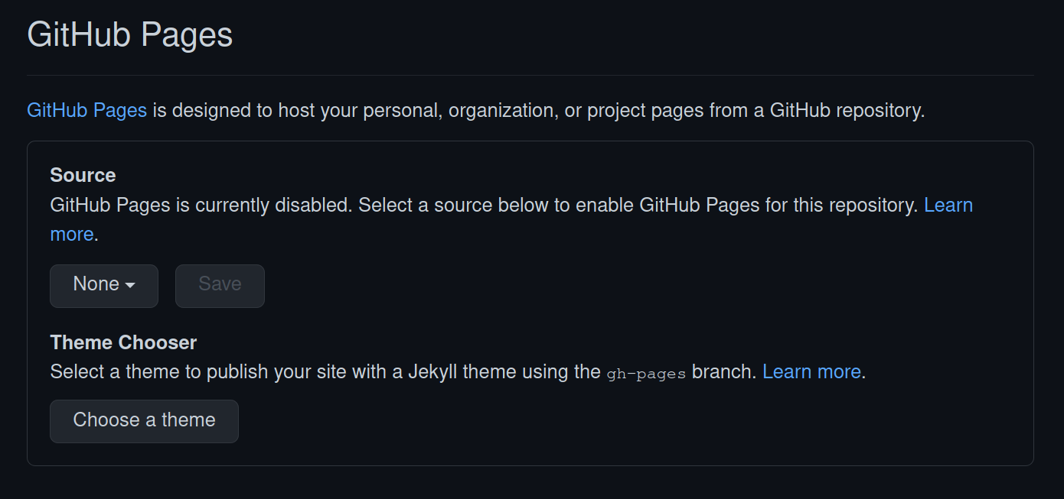
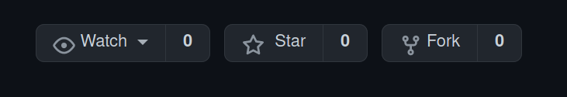
Git and Github Features
Issues
Keep track of tasks, enhancements, and bugs
Like an email or report that can be discussed and shared
GitHub Pages
Static site hosting service
Created directly from content in the repository
R

Slide 20
Git Cheat Sheet
https://education.github.com/git-cheat-sheet-education.pdf

Slide 21
Links and References
Group B - Next Week's Topic: https://forms.gle/GA5LsAQMCiqHmYT68
Official Git Documentation: https://git-scm.com/docs
Git CLI and GUI tools
Hub: https://github.com/github/hub
Github CLI: https://cli.github.com/
Github Desktop: https://desktop.github.com/
Git Tower (and others): https://www.git-tower.com/mac
VS Code's integrated Version Control: https://code.visualstudio.com/docs/editor/github
Git "Providers":
Github
Gitlab
Gitea
etc...

